Slide 1



Java Message Service
Asynchronous communication between applications
www.supinfo.com
Copyright © SUPINFO. All rights reserved
Notes:
© SUPINFO International University - http://www.supinfo.com
SUPINFO vous permet de partager ce document
Vous êtes libre de :
Partager — reproduire, distribuer et communiquer ce document Remixer — modifier ce document
A condition de respecter les règles suivantes :
Indication obligatoire de la paternité — Vous devez obligatoirement préciser l’origine « SUPINFO » du document au début de celui-ci de la même manière qu’indiqué par SUPINFO International University – Notamment en laissant obligatoirement la première et la dernière page du document, mais pas d'une manière qui suggérerait que SUPINFO International University vous soutiennent ou approuvent votre utilisation du document, surtout si vous le modifiez. Dans ce dernier cas, il vous faudra obligatoirement supprimer le texte « SUPINFO Official Document » en tête de page et préciser notamment la page indiquant votre identité et les modifications principales apportées.
En dehors de ces dispositions, aucune autre modification de la première et de la dernière page du document n’est autorisée.
NOTE IMPORTANTE : Ce document est mis à disposition selon le contrat CC-BY-NC-SA Creative Commons disponible en ligne http://creativecommons.org/licenses ou par courrier postal à Creative Commons, 171 Second Street, Suite 300, San Francisco, California 94105, USA modifié en ce sens que la première et la dernière page du document ne peuvent être supprimées en cas de reproduction, distribution, communication ou modification. Vous pouvez donc reproduire, remixer, arranger et adapter ce document à des fins non commerciales tant que vous respectez les règles de paternité et que les nouveaux documents sont protégés selon des termes identiques. Les autorisations au-delà du champ de cette licence peuvent être obtenues à support@supinfo.com.
© SUPINFO International University – EDUCINVEST - Rue Ducale, 29 - 1000 Brussels Belgium . www.supinfo.com

Slide 2


Java Message Service
Course objectives
By completing this course, you will be able to:
Explain what JMS is
Develop messaging service based on it
Develop Message Driven Beans
Notes:
[Title of the course]
Nov 8, 2008
Copyright © 2004-2005 NameOfTheOrganization. All rights reserved.
2

Slide 3

Java Message Service
Course topics
Course’s plan
Concepts
JMS API
Message Driven Bean
Notes:
[Title of the course]
Nov 8, 2008
Copyright © 2004-2005 NameOfTheOrganization. All rights reserved.
3

Slide 4
Concepts
What is this another Javacronym ?
Notes:
[Title of the course]
Nov 8, 2008
Copyright © 2004-2005 NameOfTheOrganization. All rights reserved.
4

Slide 5


Concepts
Presentation
Used when some information should be exchanged between :
Two applications : point-to-point model
Several applications : publish and subscribe model
Asynchronous system
Producer doesn’t wait the consumer(s) reception
Messages are received when the consumer(s) request them
Similar to a mail system
Notes:
[Title of the course]
Nov 8, 2008
Copyright © 2004-2005 NameOfTheOrganization. All rights reserved.
5

Slide 6

Concepts
Presentation
JMS require different actors :
A provider, which stores messages and sends them to consumers
A producer, which sends messages
One or several consumers, which receives messages
Notes:
[Title of the course]
Nov 8, 2008
Copyright © 2004-2005 NameOfTheOrganization. All rights reserved.
6

Slide 7
Concepts
Destination
A destination could be compared to a mailbox
The producer creates a message for a specific destination
The provider stores the message until the consumer receives it
Producer
Consumer
Provider
Notes:
[Title of the course]
Nov 8, 2008
Copyright © 2004-2005 NameOfTheOrganization. All rights reserved.
7

Slide 8
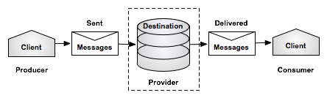
Concepts
Queue
Queue mode
Notes:
[Title of the course]
Nov 8, 2008
Copyright © 2004-2005 NameOfTheOrganization. All rights reserved.
8

Slide 9
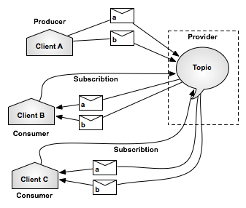
Concepts
Topic
Topic mode
Notes:
[Title of the course]
Nov 8, 2008
Copyright © 2004-2005 NameOfTheOrganization. All rights reserved.
9

Slide 10


Concepts
Stop-and-think
Do you have any questions ?
Notes:
[Title of the course]
Nov 8, 2008
Copyright © 2004-2005 NameOfTheOrganization. All rights reserved.
10
10

Slide 11
JMS API
How the API works ?
Notes:
[Title of the course]
Nov 8, 2008
Copyright © 2004-2005 NameOfTheOrganization. All rights reserved.
11

Slide 12
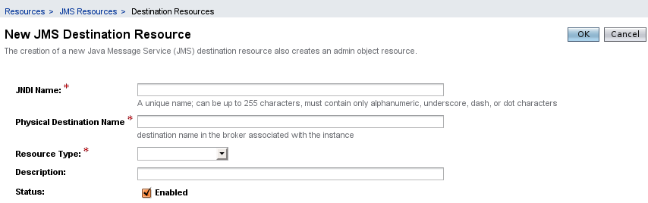
JMS API
Destination
With GlassFish, we can create Queues and Topics directly inside the administration console :
Notes:
[Title of the course]
Nov 8, 2008
Copyright © 2004-2005 NameOfTheOrganization. All rights reserved.
12

Slide 13

JMS API
Send a message
In order to send a message, we have to :
Reclaim required objects via JNDI
A ConnectionFactory (service provider)
A Destination (Queue or Topic)
Create a Connection using the factory
Open a Session using the connection
Create a MessageProducer
Send the message
Notes:
[Title of the course]
Nov 8, 2008
Copyright © 2004-2005 NameOfTheOrganization. All rights reserved.
13

Slide 14
JMS API
Send a message
Context ctx = new InitialContext();
ConnectionFactory connectionFactory = (ConnectionFactory) ctx.lookup("ConnectionFactory");
Destination destination = (Destination) ctx.lookup("queue/StockValue");
Connection cnx = connectionFactory.createConnection();
Session session = cnx.createSession(false, Session.AUTO_ACKNOWLEDGE);
MessageProducer producer = session.createProducer(destination);
TextMessage message = session.createTextMessage();
message.setText("Your 'Microsoft' stock has been sold !");
producer.send(message);
cnx.close();
Notes:
[Title of the course]
Nov 8, 2008
Copyright © 2004-2005 NameOfTheOrganization. All rights reserved.
14

Slide 15

JMS API
Receive a message
We need the same objects : ConnectionFactory, Destination, Connection and Session
Create a MessageConsumer instead of a MessageProducer
Two ways to receive a message
Blocking, waiting for a message
Non-blocking, using a message listener
A message listener is similar to an event listener : it "subscribes" to a particular destination and receives messages each time there's a new one
Notes:
[Title of the course]
Nov 8, 2008
Copyright © 2004-2005 NameOfTheOrganization. All rights reserved.
15

Slide 16
JMS API
Receive a message
Blocking mode
Non-blocking mode, using a listener
MessageConsumer consumer = session.createConsumer(destination);
// Retrieve a single message
Message receivedMessage = consumer.receive();
MessageConsumer consumer = session.createConsumer(destination);
consumer.setMessageListener(new MessageListener() {
public void onMessage(Message message) {
// Called each time a message is received
}
});
Notes:
[Title of the course]
Nov 8, 2008
Copyright © 2004-2005 NameOfTheOrganization. All rights reserved.
16

Slide 17
JMS API
Receive a message
Don’t forget to start the connection !
Message receivedMessage = consumer.receive();
connection.start();
Notes:
[Title of the course]
Nov 8, 2008
Copyright © 2004-2005 NameOfTheOrganization. All rights reserved.
17

Slide 18
JMS API
Messages
There are three different types of messages :
TextMessage to send simple text
ObjectMessage for a serialized object
MapMessage contains a map with strings as keys and objects as values
Notes:
[Title of the course]
Nov 8, 2008
Copyright © 2004-2005 NameOfTheOrganization. All rights reserved.
18

Slide 19
JMS API
Stop-and-think
Do you have any questions ?
Notes:
[Title of the course]
Nov 8, 2008
Copyright © 2004-2005 NameOfTheOrganization. All rights reserved.
19
19

Slide 20
Message Driven Bean
An EJB for JMS ?
Notes:
[Title of the course]
Nov 8, 2008
Copyright © 2004-2005 NameOfTheOrganization. All rights reserved.
20

Slide 21
Message Driven Bean
Presentation
A Message Driven Bean is a specific component for receiving messages
Annotation used is @MessageDriven
Destination name and type are declared in the annotation
Implements javax.jms.MessageListener
Method onMessage(Message m)
Called at the moment of receipt
Notes:
[Title of the course]
Nov 8, 2008
Copyright © 2004-2005 NameOfTheOrganization. All rights reserved.
21

Slide 22
Message Driven Bean
Example
@MessageDriven(
mappedName="queue/StockValue",
activationConfig = {
@ActivationConfigProperty (
propertyName = "destinationType",
propertyValue = "javax.jms.Queue »
)
}
)
class MyDrivenBean implements MessageListener {
// This method is called when a message is received
public void onMessage(Message message) {
TextMessage textMessage = (TextMessage) message;
System.out.println(textMessage.getText());
}
}
Notes:
[Title of the course]
Nov 8, 2008
Copyright © 2004-2005 NameOfTheOrganization. All rights reserved.
22

Slide 23
Message Driven Bean
EJB context
EJBs (session beans and MDB) can obtain JMS ConnectionFactory and Destination objects via resource injection !
@Resource(mappedName="ConnectionFactory")‏
private ConnectionFactory connectionFactory;
@Resource(mappedName="queue/StockValue")‏
private Destination destination;
Notes:
[Title of the course]
Nov 8, 2008
Copyright © 2004-2005 NameOfTheOrganization. All rights reserved.
23

Slide 24
Message Driven Bean
Stop-and-think
Do you have any questions ?
Notes:
[Title of the course]
Nov 8, 2008
Copyright © 2004-2005 NameOfTheOrganization. All rights reserved.
24
24

Slide 25

Java Message Service
Fill in the blanks
messages
Thanks to the JMS technology we could send ………….
Message Driven Bean allow to ………. messages.
There are 2 message distribution modes:
……………….. and ………………..
receive
Queue
Topic
Notes:
[Title of the course]
Nov 8, 2008
Copyright © 2004-2005 NameOfTheOrganization. All rights reserved.
25

Slide 26


Exercise (1/2)
Java Message Service
SupRails wants to print train tickets after each order
They want another application to manage that
This application will be on another server
So you need to use JMS to send message from your web application to the printer application !

Slide 27
Exercise (2/2)
Java Message Service
Develop a simple console application
This application must retrieve JMS message from a queue and display corresponding tickets to the console (SupRails doesn’t buy printers yet…)
Update your web application to send a message to a queue when a trip is ordered

Slide 28

Course summary
Java Message Service
Destination
Topic
Queue
Message Driven Bean

Slide 29


The end
Java Message Service

